Slide 1
Design

Slide 2
Software Design
Design activity begins with a set of requirements, and maybe an architecture
Design done before the system is implemented
Design focuses on module view – i.e. what modules should be in the system
Module view may have easy or complex relationship with the C&C view
Design of a system is a blue print for implementation
Often has two levels – high level (modules are defined), and detailed design (logic specified)

Slide 3
Design…
Design is a creative activity
Goal: to create a plan to satisfy requirements
Perhaps the most critical activity during system development
Design determines the major characteristics of a system
Has great impact on testing and maintenance
Design document forms reference for later phases
Design methodology – systematic approach for creating a design

Slide 4
Design Concepts
Design is correct, if it will satisfy all the requirements and is consistent with architecture
Of the correct designs, we want best design
We focus on modularity as the main criteria (besides correctness)

Slide 5
Modularity
Modular system – in which modules can be built separately and changes in one have minimum impact on others
Modularity supports independence of models
Modularity enhances design clarity, eases implementation
Reduces cost of testing, debugging and maintenance
Cannot simply chop a program into modules to get modularly
Need some criteria for decomposition – coupling and cohesion are such criteria

Slide 6
Coupling
Independent modules: if one can function completely without the presence of other
Independence between modules is desirable
  Modules can be modified separately
  Can be implemented and tested separately
  Programming cost decreases
In a system all modules cannot be independent
Modules must cooperate with each other
More connections between modules
  More dependent they are
  More knowledge about one module is required to understand the other module.
Coupling captures the notion of dependence

Slide 7
Coupling…
Coupling between modules is the strength of interconnections between modules
In general, the more we must know about module A in order to understand module B the more closely connected is A to B
"Highly coupled" modules are joined by strong interconnection
"Loosely coupled" modules have weak interconnections

Slide 8
Coupling…
Goal: modules as loosely coupled as possible
Where possible, have independent modules
Coupling is decided during high level design
Cannot be reduced during implementation
Coupling is inter-module concept
Major factors influencing coupling
  Type of connection between modules
  Complexity of the interface
  Type of information flow between modules

Slide 9
Coupling – Type of connection
Complexity and obscurity of interfaces increase coupling
Minimize the number of interfaces per module
Minimize the complexity of each interface
Coupling is minimized if
  Only defined entry of a module is used by others
  Information is passed exclusively through parameters
Coupling increases if
  Indirect and obscure interface are used
  Internals of a module are directly used
  Shared variables employed for communication

Slide 10
Coupling – interface complexity
Coupling increases with complexity of interfaces eg. number and complexity of parms
Interfaces are needed to support required communication
Often more than needed is used eg. passing entire record when only a field is needed
Keep the interface of a module as simple as possible

Slide 11
Coupling – Type of Info flow
Coupling depends on type of information flow
Two kinds of information: data or control.
Transfer of control information
  Action of module depends on the information
  Makes modules more difficult to understand
Transfer of data information
  Module can be treated as input-output function
Lowest coupling: interfaces with only data communication
Highest: hybrid interfaces

Slide 12
Coupling - Summary
Coupling Interface Type of Type of
complexity connections commu-
nication
Low Simple to module data
obvious by name
High complicated to internal Hybrid
obscure elements

Slide 13
Coupling in OO Systems
In OO systems, basic modules are classes, which are richer than fns
OO Systems have three types of coupling
  Interaction coupling
  Component coupling
  Inheritance coupling

Slide 14
Coupling in OO - Interaction
Interaction coupling occurs due to methods of a class invoking methods of other classes
  Like calling of functions
  Worst form if methods directly access internal parts of other methods
  Still bad if methods directly manipulate variables of other classes
  Passing info through tmp vars is also bad

Slide 15
Coupling in OO …
Least interaction coupling if methods communicate directly with parameters
  With least number of parameters
  With least amount of info being passed
  With only data being passed
I.e. methods should pass the least amount of data, with least no of parms

Slide 16
Coupling in OO - Component
Component coupling – when a class A has variables of another class C
  A has instance vars of C
  A has some parms of type C
  A has a method with a local var of type C
When A is coupled with C, it is coupled with all subclasses of C as well
Component coupling will generally imply the presence of interaction coupling also

Slide 17
Coupling in OO - Inheritance
Inheritance coupling – two classes are coupled if one is a subclass of other
Worst form – when subclass modifies a signature of a method or deletes a method
Coupling is bad even when same signature but a changed implementation
Least, when subclass only adds instance vars and methods but does not modify any

Slide 18
Cohesion
Coupling characterized the inter-module bond
Reduced by minimizing relationship between elts of different modules
Another method of achieving this is by maximizing relationship between elts of same module
Cohesion considers this relationship
Interested in determining how closely the elements of a module are related to each other
In practice both are used

Slide 19
Cohesion…
Cohesion of a module represents how tightly bound are the elements of the module
Gives a handle about whether the different elements of a module belong together
High cohesion is the goal
Cohesion and coupling are interrelated
Greater cohesion of modules, lower coupling between module
Correlation is not perfect.

Slide 20
Levels of Cohesion
There are many levels of cohesion.
  Coincidental
  Logical
  Temporal
  Communicational
  Sequential
  Functional
Coincidental is lowest, functional is highest
Scale is not linear
Functional is considered very strong

Slide 21
Determining Cohesion
Describe the purpose of a module in a sentence
Perform the following tests
  1. If the sentence has to be a compound sentence, contains more than one verbs, the module is probably performing more than one function. Probably has sequential or communicational cohesion.
  2. If the sentence contains words relating to time, like "first", "next", "after", "start" etc., the module probably has sequential or temporal cohesion.

Slide 22
3. If the predicate of the sentence does not contain a single specific object following the verb, the module is probably logically cohesive. Eg "edit all data", while "edit source data" may have functional cohesion.
4. Words like "initialize", "clean-up" often imply temporal cohesion.
Functionally cohesive module can always be described by a simple statement

Slide 23
Cohesion in OO Systems
In OO, different types of cohesion is possible as classes are the modules
  Method cohesion
  Class cohesion
  Inheritance cohesion
Method cohesion – why diff code elts are together in a method
  Like cohesion in functional modules; highest form is if each method implements a clearly defined function with all elts contributing to implementing this function

Slide 24
Cohesion in OO…
Class cohesion – why diff attributes and methods are together in a class
  A class should represent a single concept with all elts contributing towards it
  Whenever multiple concepts encapsulated, cohesion is not as high
  A symptom of multiple concepts – diff gps of methods accessing diff subsets of attributes

Slide 25
Cohesion in OO…
Inheritance cohesion – focuses on why classes are together in a hierarchy
  Two reasons for subclassing – generalization-specialization and reuse
  Cohesion is higher if the hierarchy is for providing generalization-specialization

Slide 26
Open-closed Principle
Besides cohesion and coupling, open closed principle also helps in achieving modularity
Principle: A module should be open for extension but closed for modification
  Behavior can be extended to accommodate new requirements, but existing code is not modified
  I.e. allows addition of code, but not modification of existing code
  Minimizes risk of having existing functionality stop working due to changes – a very important consideration while changing code
  Good for programmers as they like writing new code

Slide 27
Open-closed Principle…
In OO this principle is satisfied by using inheritance and polymorphism
Inheritance allows creating a new class to extend behavior without changing the original class
This can be used to support the open-closed principle
Consider example of a client object which interacts with a printer object for printing

Slide 28
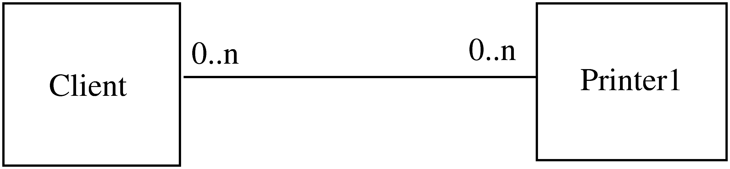
Example

Slide 29
Example..
Client directly calls methods on Printer1
If another printer is to be allowed
  A new class Printer2 will be created
  But the client will have to be changed if it wants to use Printer 2
Alternative approach
  Have Printer1 a subclass of a general Printer
  For modification, add another subclass Printer 2
  Client does not need to be changed

Slide 30
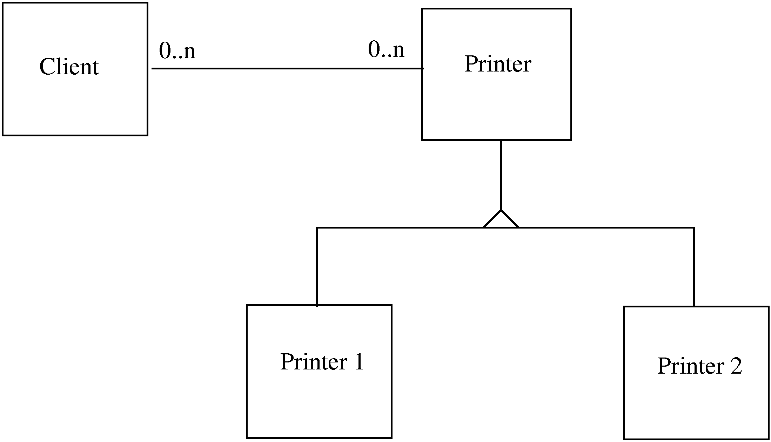
Example…

Slide 31
Liskov’s Substitution Principle
Principle: Program using object o1 of base class C should remain unchanged if o1 is replaced by an object of a subclass of C
If hierarchies follow this principle, the open-closed principle gets supported

Slide 32
Summary
Goal of designing is to find the best possible correct design
Modularity is the criteria for deciding quality of the design
Modularity enhanced by low coupling, high cohesion, and following open-closed principle

